Slide 1

Asymmetric/ Public Key Cryptography
Digital Signatures

Slide 2

Digital Signatures
A mathematical scheme for demonstrating the authenticity of a digital message or document.
A valid digital signature gives a recipient reason to believe that the message was created by a known sender, and that it was not altered in transit.
Digital signatures can also provide non-repudiation, meaning that the signer cannot successfully claim they did not sign a message, while also claiming their private key remains secret.
Some non-repudiation schemes offer a time stamp for the digital signature, so that even if the private key is exposed, the signature is valid nonetheless
Let us begin by looking at the differences between conventional signatures and digital signatures.

Slide 3

Digital Signatures vs Conventional
Inclusion: A conventional signature is included in the document; it is part of the document. But when we sign a document digitally, we send the signature as a separate document.
Verification Method: For a conventional signature, when the recipient receives a document, she compares the signature on the document with the signature on file (stored copy).
For a digital signature, the recipient receives the message and the signature. The recipient applies a verification technique to the combination of the message and the signature to verify the authenticity.
Relationship: One to many relationship in conventional signatures. One signature many documents. In Digital signature, different signature for different message.
Duplicity: In conventional signature, a copy of the signed document can be distinguished from the original one on file. In digital signature, there is no such distinction unless there is a factor of time on the document.

Slide 4
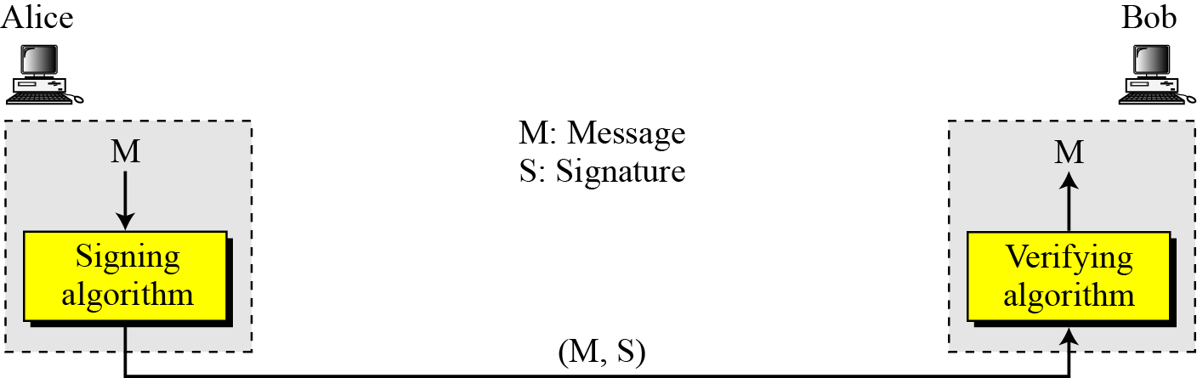
Digital Signatures: The Process
The sender uses a signing algorithm to sign the message.
The message and the signature are sent to the receiver.
The receiver receives the message and the signature and applies the verifying algorithm to the combination.
If the result is true, the message is accepted; otherwise, it is rejected.

Slide 5
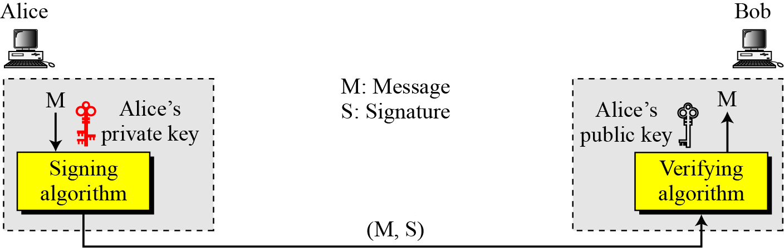
Digital Signatures: The Process
A digital signature needs a public-key system.
The signer signs with her private key; the verifier verifies with the signer’s public key.
A cryptosystem uses the private and public keys of the receiver: a digital signature uses the private and public keys of the sender

Slide 6
Digital Signatures: The Process
We know that messages can be long and Asymmetric Cryptography is slow, so one solution is to sign the digest of the message rather than the whole message. Here is the idea.
A simple hash function takes some input, usually of indefinite length, and produces a small number that is significantly shorter than the input.
The function is many to one , in that many (possibly infinite) inputs may generate the same output value.
The function is also deterministic in that the same output value is always generated for identical inputs

Slide 7
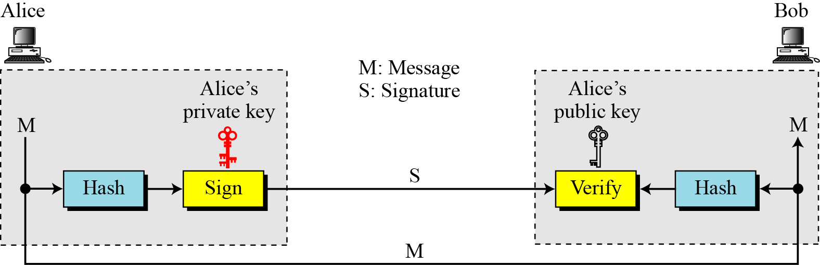
Digital Signatures: The Process
A message digest is also a hash function. It takes a variable length input - often an entire disk file - and reduces it to a small value (typically 128 to 512 bits).
Give it the same input, and it always produces the same output. And, because the output is very much smaller than the potential input, for at least one of the output values there must be more than one input value that can produce it;
We would expect that to be true for all possible output values for a good message digest algorithm.
Here is the process

Slide 8
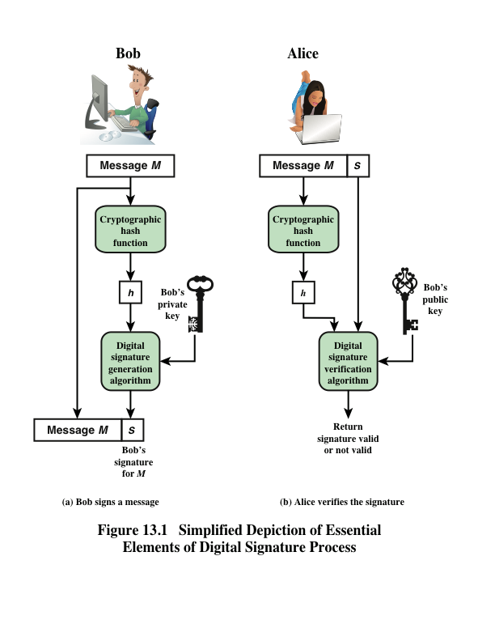
Notes:
Figure 13.1 is a generic model of the process of constructing and using digital
signatures. All of the digital signature schemes discussed in this chapter have this
structure.
Suppose that Bob wants to send a message to Alice. Although it is not
important that the message be kept secret, he wants Alice to be certain that the
message is indeed from him. For this purpose, Bob uses a secure hash function, such
as SHA-512, to generate a hash value for the message. That hash value, together
with Bob’s private key serves as input to a digital signature generation algorithm,
which produces a short block that functions as a digital signature . Bob sends the
message with the signature attached.
When Alice receives the message plus signature,
she (1) calculates a hash value for the message; (2) provides the hash value and
Bob’s public key as inputs to a digital signature verification algorithm. If the algorithm
returns the result that the signature is valid, Alice is assured that the message
must have been signed by Bob. No one else has Bob’s private key and therefore no
one else could have created a signature that could be verified for this message with
Bob’s public key. In addition, it is impossible to alter the message without access to
Bob’s private key, so the message is authenticated both in terms of source and in
terms of data integrity.
We begin this chapter with an overview of digital signatures. We then present the
Elgamal and Schnorr digital signature schemes, understanding of which makes it easier
to understand the NIST Digital Signature Algorithm (DSA). The chapter then covers
the two other important standardized digital signature schemes: the Elliptic Curve
Digital Signature Algorithm (ECDSA) and the RSA Probabilistic Signature Scheme
(RSA-PSS).

Slide 9
Digital Signature Properties
It must verify the author and the date and time of the signature
It must authenticate the contents at the time of the signature
It must be verifiable by third parties to resolve disputes
Notes:
Message authentication protects two parties who exchange messages from any third
party. However, it does not protect the two parties against each other. Several forms
of dispute between the two are possible.
In situations where there is not complete trust between sender and receiver,
something more than authentication is needed. The most attractive solution to
this problem is the digital signature. The digital signature must have the following
properties:
• It must verify the author and the date and time of the signature.
• It must authenticate the contents at the time of the signature.
• It must be verifiable by third parties to resolve disputes.
Thus, the digital signature function includes the authentication function.

Slide 10
Digital Signatures: Services
A digital signature can directly provide the support for Message Authentication, Message Integrity and Non-repudiation.
Message Authentication:
Digital Signatures, like a secure conventional signature can provide message authentication.
Bob can verify that message is sent by Alice as Alice’s public key is used for verification.
Alice’s Public Key cannot verify the signature signed by Eve’s Private Key.
Message Integrity:
The integrity of the message is preserved even if we sign the whole message because we cannot get the same signature if the message is changed.

Slide 11
Digital Signatures: Services
Non-Repudiation:
Alice signs a message and later denies it, can Bob later prove that Alice actually signed it?
Alice asks Bob(Bank) to transfer 100000 from her account to Ted’s account. Later denies sending message (Bob may have problem)
Alice must keep the signature on file and later use Alice’s public key to create the original message to prove that message in the file and newly created message are the same
But what if Alice has changed her private/public key during this time?
She may claim that the signature is not authentic
One solution is the trusted third party
A trusted third party may solve other problems related to security services and key exchange. Here is how it can work

Slide 12
Digital Signatures: Services
Non-Repudiation:
Alice creates a signature from her message (SA) and sends the message, her identity, Bob’s identity and the signature to the center (Third Party)
The center after checking that Alice’s public key is valid, verifies through Alice’s public key that the message came from Alice.
Center saves the copy of the message with the sender identity, recipient identity and a timestamp in its archive.
The center uses its private key to create another signature (ST) from the message.
The center sends the message, the new signature, Alice’s identity, and Bob’s identity to Bob.
Bob verifies the public key of the trusted center.
If Alice later denies, the center can show a copy of the saved message.
If Bob’s message is duplicate of the message saved at the center then Alice loses.
Another level of Encryption/ Decryption can be added to scheme as discussed in Confidentiality.

Slide 13
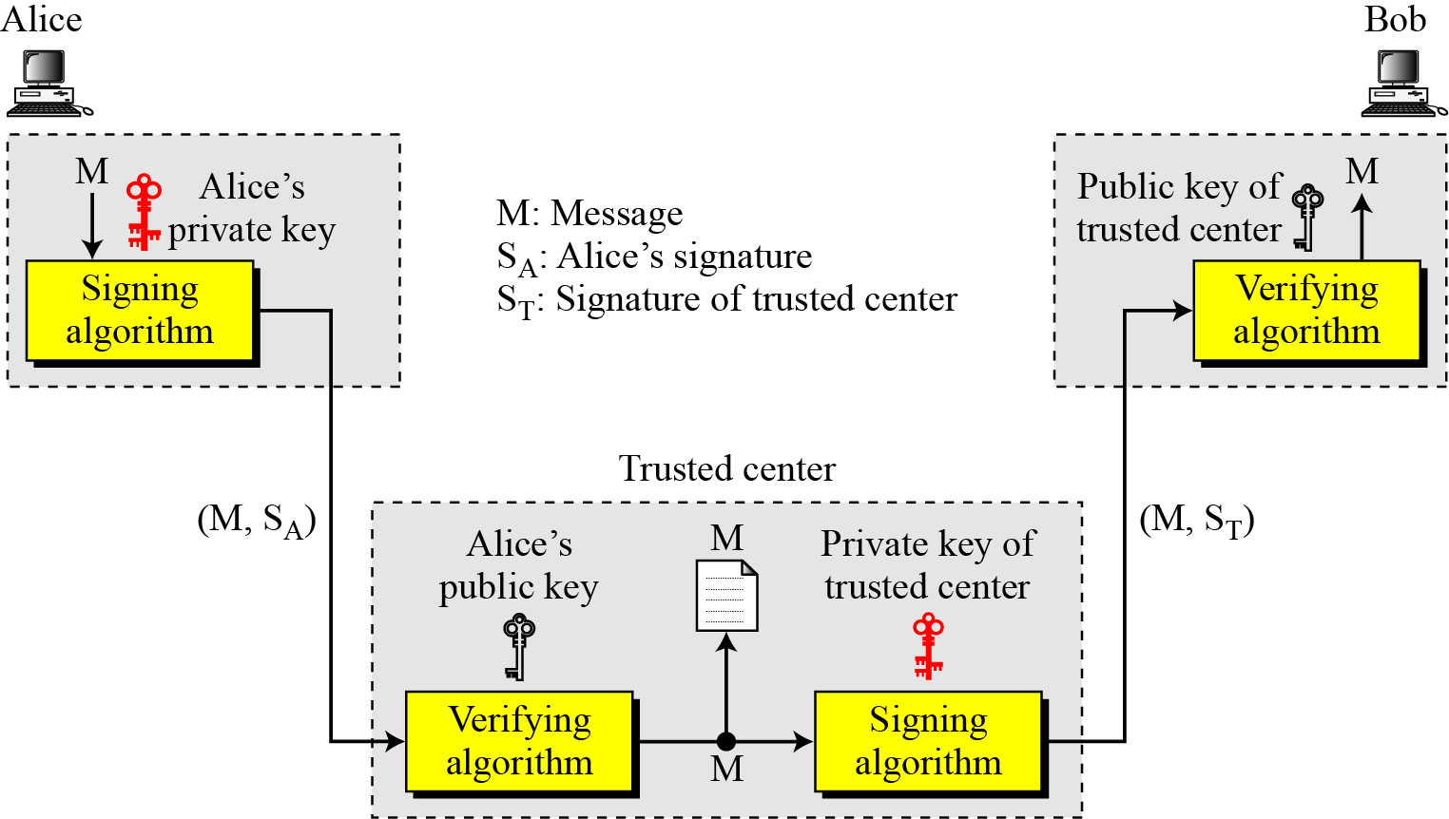
Digital Signatures: Services
Non-Repudiation:
Notes:
CA: Certification Authority

Slide 14
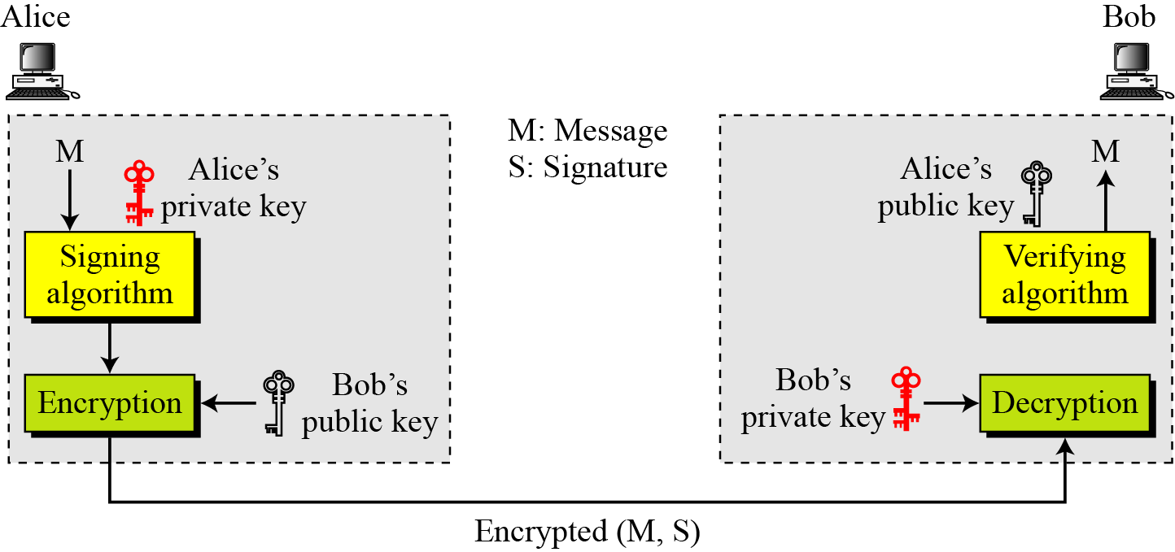
Digital Signatures: Services
Confidentiality:
A digital signature itself doesn’t provide confidentiality directly.
If confidentiality is needed, If there is a need for privacy, another layer of encryption/decryption must be applied.

Slide 15
Attacks
Key-only attack
C only knows A’s public key
Known message attack
C is given access to a set of messages and their signatures
Generic chosen message attack
C chooses a list of messages before attempting to break A’s signature scheme, independent of A’s public key; C then obtains from A valid signatures for the chosen messages
Directed chosen message attack
Similar to the generic attack, except that the list of messages to be signed is chosen after C knows A’s public key but before any signatures are seen
Adaptive chosen message attack
C may request from A signatures of messages that depend on previously obtained message-signature pairs
Notes:
[GOLD88] lists the following types of attacks, in order of increasing severity. Here
A denotes the user whose signature method is being attacked, and C denotes the
attacker.
• Key-only attack: C only knows A’s public key.
• Known message attack: C is given access to a set of messages and their
signatures.
• Generic chosen message attack: C chooses a list of messages before attempting
to breaks A’s signature scheme, independent of A’s public key. C then
obtains from A valid signatures for the chosen messages. The attack is generic,
because it does not depend on A’s public key; the same attack is used against
everyone.
• Directed chosen message attack: Similar to the generic attack, except that the
list of messages to be signed is chosen after C knows A’s public key but before
any signatures are seen.
• Adaptive chosen message attack: C is allowed to use A as an “oracle.” This
means that C may request from A signatures of messages that depend on previously
obtained message-signature pairs.

Slide 16
Attacks on Digital Signatures
We shall now concentrate on types of attack and different forgery types
Attack Types
Key Only Attack:
Eve has access only to the public information of Alice
To forge a message, Eve needs to create Alice’s signature (Trying out possibilities)
Known-message Attack
Eve has access to some documents previously signed by Alice
Eve tries to create another message and forge Alice’s signature
Chosen Message Attack
Eve somehow makes Alice sign one or more messages for her.
Eve now has a chosen-message/signature pair
Eve later creates another message, with the content she wants, and forges Alice’s signature on it

Slide 17
Forgeries
Total break
C determines A’s private key
Universal forgery
C finds an efficient signing algorithm that provides an equivalent way of constructing signatures on arbitrary messages
Selective forgery
C forges a signature for a particular message chosen by C
Existential forgery
C forges a signature for at least one message; C has no control over the message
Notes:
[GOLD88] then defines success at breaking a signature scheme as an outcome
in which C can do any of the following with a non-negligible probability:
• Total break: C determines A’s private key.
• Universal forgery: C finds an efficient signing algorithm that provides an
equivalent way of constructing signatures on arbitrary messages.
• Selective forgery: C forges a signature for a particular message chosen by C.
• Existential forgery: C forges a signature for at least one message. C has no
control over the message. Consequently, this forgery may only be a minor nuisance
to A.

Slide 18
Attacks on Digital Signatures
If the attack is successful, the result is a forgery
Forgery Types
Existential Forgery
Eve may be able to create a valid message-signature pair, but not one that she can really use. In other
Message content may have been randomly calculated
This type of forgery is probably, but EVE cannot benefit as the message is unintelligible.
Selective Forgery
Eve may be able to forge Alice’s signature on a message with the content selectively chosen by Eve.
The probability of such forgery is low, but not negligible.

Slide 19
Digital Signature Requirements
The signature must be a bit pattern that depends on the message being signed
The signature must use some information unique to the sender to prevent both forgery and denial
It must be relatively easy to produce the digital signature
It must be relatively easy to recognize and verify the digital signature
It must be computationally infeasible to forge a digital signature, either by constructing a new message for an existing digital signature or by constructing a fraudulent digital signature for a given message
It must be practical to retain a copy of the digital signature in storage
Notes:
On the basis of the properties and attacks just discussed, we can formulate the following
requirements for a digital signature.
• The signature must be a bit pattern that depends on the message being signed.
• The signature must use some information unique to the sender to prevent
both forgery and denial.
• It must be relatively easy to produce the digital signature.
• It must be relatively easy to recognize and verify the digital signature.
• It must be computationally infeasible to forge a digital signature, either by
constructing a new message for an existing digital signature or by constructing
a fraudulent digital signature for a given message.
• It must be practical to retain a copy of the digital signature in storage.
A secure hash function, embedded in a scheme such as that of Figure 13.2, provides
a basis for satisfying these requirements. However, care must be taken in the design
of the details of the scheme.

Slide 20
Direct Digital Signature
Refers to a digital signature scheme that involves only the communicating parties
It is assumed that the destination knows the public key of the source
Confidentiality can be provided by encrypting the entire message plus signature with a shared secret key
It is important to perform the signature function first and then an outer confidentiality function
In case of dispute some third party must view the message and its signature
The validity of the scheme depends on the security of the sender’s private key
If a sender later wishes to deny sending a particular message, the sender can claim that the private key was lost or stolen and that someone else forged his or her signature
One way to thwart or at least weaken this ploy is to require every signed message to include a timestamp and to require prompt reporting of compromised keys to a central authority
Notes:
The term direct digital signature refers to a digital signature scheme that involves
only the communicating parties (source, destination). It is assumed that the destination
knows the public key of the source.
Confidentiality can be provided by encrypting the entire message plus signature
with a shared secret key (symmetric encryption). Note that it is important to
perform the signature function first and then an outer confidentiality function. In
case of dispute, some third party must view the message and its signature. If the signature
is calculated on an encrypted message, then the third party also needs access
to the decryption key to read the original message. However, if the signature is the
inner operation, then the recipient can store the plaintext message and its signature
for later use in dispute resolution.
The validity of the scheme just described depends on the security of the sender’s
private key. If a sender later wishes to deny sending a particular message, the sender
can claim that the private key was lost or stolen and that someone else forged his or her
signature. Administrative controls relating to the security of private keys can be employed
to thwart or at least weaken this ploy, but the threat is still there, at least to some
degree. One example is to require every signed message to include a timestamp (date
and time) and to require prompt reporting of compromised keys to a central authority.
Another threat is that some private key might actually be stolen from X
at time T. The opponent can then send a message signed with X’s signature and
stamped with a time before or equal to T.
The universally accepted technique for dealing with these threats is the use
of a digital certificate and certificate authorities. We defer a discussion of this topic
until Chapter 14, and focus in this chapter on digital signature algorithms.

Slide 21
Digital Signatures Schemes
Several digital signature schemes have evolved during the last few decades.
RSA Digital Signature Scheme
ElGamal Digital Signature Scheme
Schnorr Digital Signature Scheme
Digital Signature Standard (DSS)
Elliptic Curve Digital Signature Scheme
The two most widely used are RSA and DSS.

Slide 22
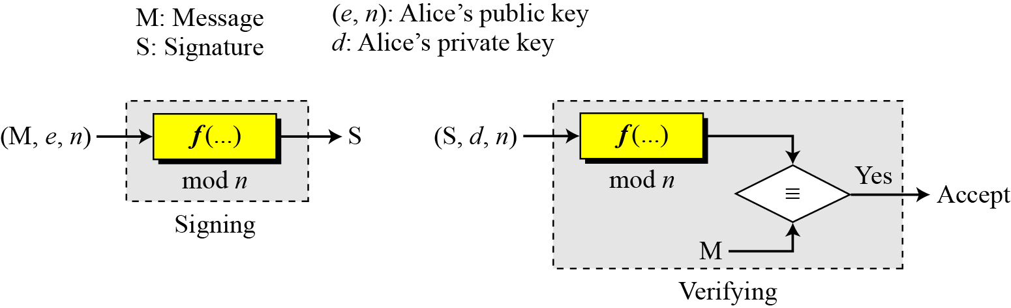
RSA Digital Signature Scheme
We have already studied RSA, same scheme can be used for Digital Signature, but with few rules changed
The private and public keys of the sender, not the receiver, are used
The sender uses her own private key to sign the document
The receiver uses the sender’s public key to verify it
We can see that the private key plays the role of the sender’s own signature, the sender’s public key plays the role of the copy of the signature that is available to the public
General idea is

Slide 23
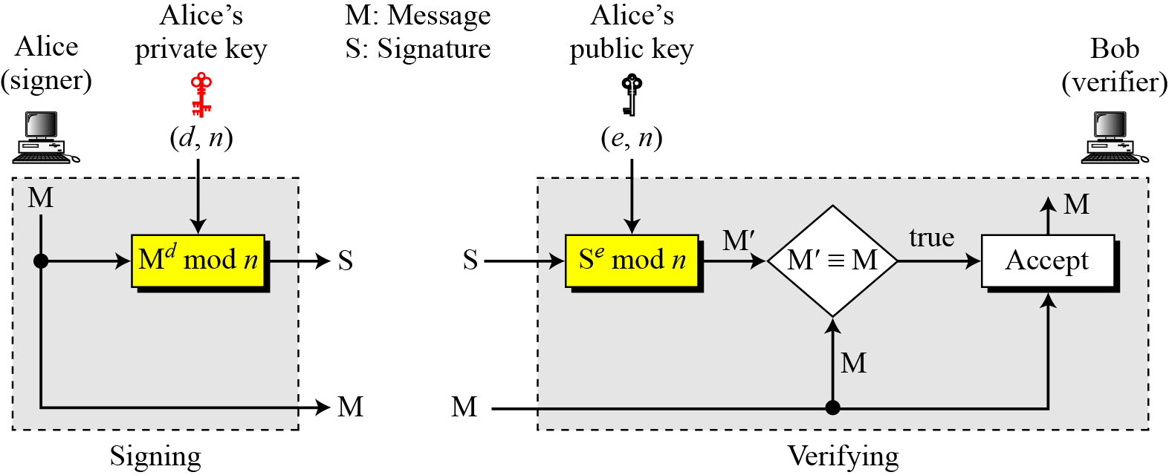
RSA Digital Signature Scheme
Key Generation:
Exactly the same as RSA
In the RSA digital signature scheme, d is private; e and n are public.

Slide 24
RSA Digital Signature Scheme
Key Generation:
suppose that Alice chooses p = 823 and q = 953, and calculates n = 784319. The value of φ(n) is 782544. Now she chooses e = 313 and calculates d = 160009. At this point key generation is complete. Now imagine that Alice wants to send a message with the value of M = 19070 to Bob. She uses her private exponent, 160009, to sign the message:
Alice sends the message and the signature to Bob. Bob receives the message and the signature. He calculates
Bob accepts the message because he has verified Alice’s signature

Slide 25
RSA Digital Signature Scheme
Attacks on RSA DSS
Key only attack:
As difficult as solving discrete logarithm problem
Even if broken, results in Existential forgery
Known Message Attack:
Eve intercepted two message-signature pairs(M₁,S₁) and (M₂, S₂), created using same private key
Now if M = (M₁ * M₂) mod n, then S=(S₁ * S₂) mod n
S = (S₁ * S₂) mod n = M₁^{d} * M₂^{d}) mod n = (M₁* M₂)^{d} mod n = M^{d} mod n
Eve can create M = (M₁*M₂) mod n, and can create S = (S₁ * S₂) mod n and can fool Bob
Easy to launch but existential forgery as the message M is multiplication of two previous messages created by Alice and not Eve.
M is useless

Slide 26
RSA Digital Signature Scheme
Attacks on RSA DSS
Chosen Message Attack:
Uses same trick as Known-message attack
Eve somehow ask Alice to sign two legitimate messages, M₁ and M₂ for her and later creates a new message M = M₁ * M₂
Eve can later claim that Alice has signed M.
This attack is also referred to as multiplicative attack.
Serious attack on RSA DSS as it can result is selective forgery
i.e. Eve can manipulate M₁ and M₂ o get a useful M

Slide 27
El Gamal Digital Signature Scheme
Alice Selects a large prime no. p and e₁ s.t. (e₁ >1 and e₁ <p)
Alice selects a random number ‘d’ s.t. d>=1 and d<p-1 as her private key
Alice calculates e₂ = e₁^{d} mod p
Her Public Key is (e₁, e₂ , p) while her private key is d
Signing:-
Alice chooses a random number r

Slide 28
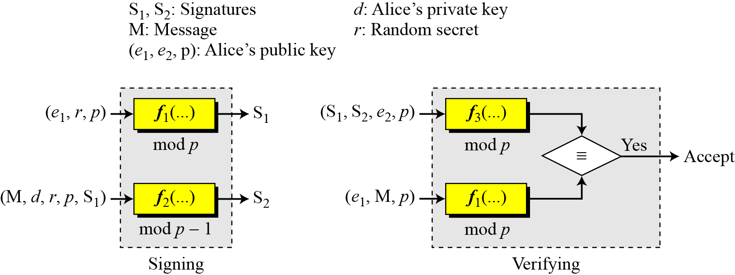
ElGamal Digital Signature Scheme
General idea behind the ElGamal digital signature scheme

Slide 29
ElGamal Digital Signature Scheme
Key Generation
The key generation procedure here is exactly the same as the one used in the cryptosystem.
In ElGamal digital signature scheme, (e₁, e₂, p) is Alice’s public key; d is her private key.

Slide 30
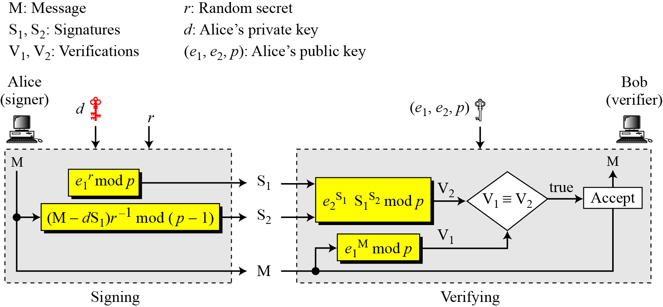
ElGamal Digital Signature Scheme
Verifying and Signing

Slide 31
A Very Simple Example
Here is a trivial example. Alice chooses p = 23, e₁ = 5, d = 6 and calculates e₂ = 5⁶ mod 23 = 8.
She also chooses r to be 3 (must be co prime with p-1). She announces e1, e2, and p (5,8,23) publicly; she keeps d secret. The following shows how Alice can sign a message 7.
S₁= e₁^{r} = 5³ mod 23 = 10
S₂ = (m-dS₁)r⁻¹ mod (p-1)
= (7- 6*10)3⁻¹ mod 22 = 13*15 mod 22 = 19
Alice sends M, S₁, and S₂ to Bob. Bob uses the public key to calculate V₁ and V₂.
V₁ = e₁^{m} mod p = 5⁷ mod 23= 17
V₂ = e₂^{S1 X} S₁^{S2} mod p = 8^{10 X} 10 ¹⁹ mod 23 = 3 ^{X} 21 mod 23 = 17 Thus Verified as V₁ = V₂

Slide 32
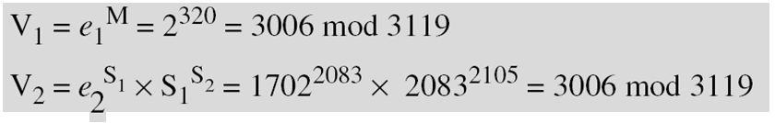
Example
Here is a trivial example. Alice chooses p = 3119, e₁ = 2, d= 127 and calculates e₂ = 2¹²⁷ mod 3119 = 1702. She also chooses r to be 307. She announces e1, e2, and p publicly; she keeps d secret. The following shows how Alice can sign a message.
Alice sends M, S₁, and S₂ to Bob. Bob uses the public key to calculate V₁ and V₂.

Slide 33
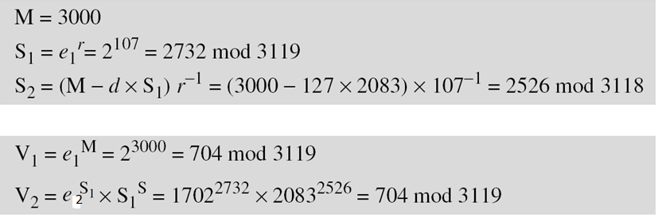
Example
Now imagine that Alice wants to send another message, M = 3000, to Ted. She chooses a new r, 107. Alice sends M, S₁, and S₂ to Ted. Ted uses the public keys to calculate V₁ and V₂.

Slide 34
Proof
V₁ = V₂
e₁^{m} mod p = e₂^{S}1 S₁^{S}2 mod p
e₁^{m} mod p = e₁^{dS}1 e₁^{rS}2 mod p
e₁^{m} mod p = e₁^{dS}1^{+rS}2 mod p
Now we know from Fermat’s Little Theorem that if p is a prime and a is a number not divisible by p Then if a^{r}= a^{s} mod p then r=s mod(p-1) and vice versa (e.g. r=4, p=11, and s=14)
m=dS₁+rS₂ mod (p-1)
m-dS₁ mod (p-1) = rS₂ mod (p-1)
S₂ =(m-dS₁)r⁻¹mod (p-1) Proved

Slide 35
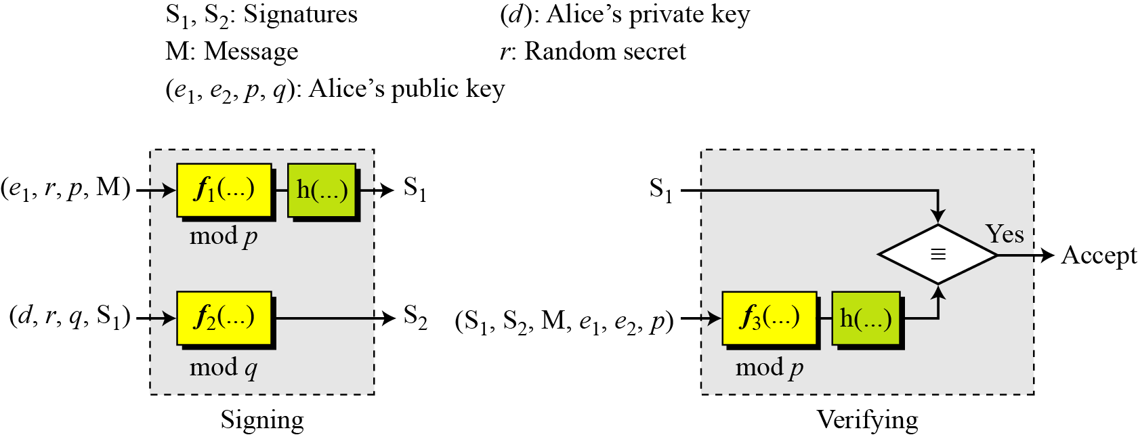
Schnorr Digital Signature Scheme
General idea behind the Schnorr digital signature scheme

Slide 36

Schnorr Digital Signature Scheme
Key Generation
Alice selects a prime p, which is usually 1024 bits in length.
Alice selects another prime q such that q divides p-1(160 bit).
Alice chooses e₁ to be the qth root of 1 modulo p i.e. e₁^{q}₌ 1 mod p .
Alice chooses an integer, d, as her private key.
Alice calculates e₂ = e₁^{d} mod p.
Alice’s public key is (e₁, e₂, p, q); her private key is (d).
Note
In the Schnorr digital signature scheme, Alice’s public key is (e₁, e₂, p, q); her private key (d).

Slide 37
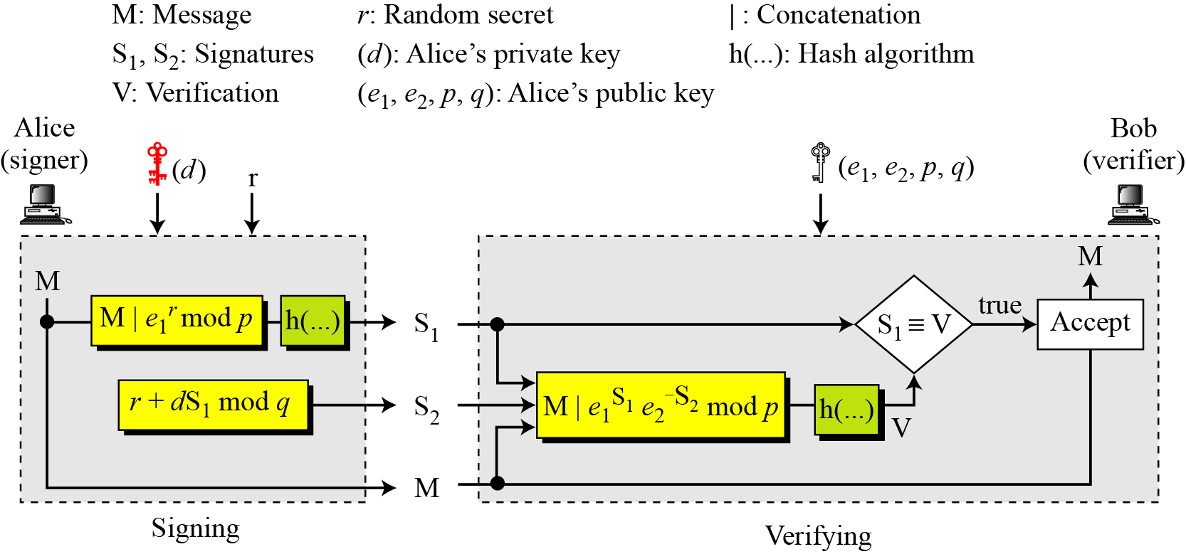
Schnorr Digital Signature Scheme
Signing and Verifying
Schnorr digital signature scheme

Slide 38
Schnorr Digital Signature Scheme
Signing
1. Alice chooses a random number r.
2. Alice calculates S₁ = h(M|e₁^{r} mod p).
3. Alice calculates S₂ = r + d × S₁ mod q.
4. Alice sends M, S₁, and S₂.
Verifying Message
1. Bob calculates V = h (M | e₁^{S2} e₂^{−S1} mod p).
2. If S₁ is congruent to V modulo p, the message is accepted;
Because
e₁^{S2} e₂^{-S1} mod p = e₁^{r+dS1} e₁^{-dS1} mod p = e₁^{r}

Slide 39
Schnorr Digital Signature Scheme
Here is a trivial example. Suppose we choose q = 5 and p = 11.
(1) Note that q divides p-1.
(2) For Selecting e₁,We first choose e₀ = 2, which is a primitive in Z₁₁* i.e. coprime with p.
(3) a^{p-1/q} = 4 mod 11 so e₁ is selected as 4 and we can see that 4⁵ mod 11 = 1 mod 11. It comes from fermat’s little theorem as we know that a^{p-1}mod p = 1, and we have calculated (a^{(p-1)/q})^{q} mod p.
(4) We choose d = 6, so e₂ = 4⁶ mod 11 = 4. Alice’s private key is now (d) i.e. 6; her public key is (e₁, e₂, p, q) i.e. (4,4,11,5).
Alice wants to send a message M. She chooses r = 3 and calculates e₂ ^{r} = 4³ = 9 mod 11. Assume that the message is 7 and concatenation means 79. Also assume that the hash of this value gives the digest h(79) = 8. This means S1 = 8. Alice calculates S2 = r + d × S₁ mod q = 3 + 6 × 8 mod 5 = 1. Alice sends the message M =7, S₁ = 8, and S₂ = 1.

Slide 40
Schnorr Digital Signature Scheme
Now Bob has to calculate V = h (M | e₁^{S2} e₂^{−S1} mod p).
4¹4⁻⁸ mod 11 = 4 (4⁸)⁻¹ or 4 (4⁻¹)⁸ mod 11 = 4(9)⁻¹ or 4(3)⁸ = 4*5 mod 11= 9 mod 11
And with the concatenation becomes 79
We know that the hash of this value is 8
So Verified

Slide 41
Schnorr Digital Signature Scheme
Here is a trivial example. Suppose we choose q = 103 and p = 2267. (1) Note that q divides p-1.
(2) For Selecting e₁,We first choose e₀ = 2, which is a primitive in Z₂₂₆₇*.
(3) As (p −1) / q = 22, so we can calculate e₁ as e₁ = 2²² mod 2267 = 354. Note that 354¹⁰³ =1 mod 2267.
(4) We choose d = 30, so e₂ = 354³⁰ mod 2267 = 1206. Alice’s private key is now (d); her public key is (e₁, e₂, p, q).
Alice wants to send a message M. She chooses r = 11 and calculates e₂ ^{r} = 354¹¹ = 630 mod 2267. Assume that the message is 1000 and concatenation means 1000630. Also assume that the hash of this value gives the digest h(1000630) = 200. This means S1 = 200. Alice calculates S2 = r + d × S₁ mod q = 11 + 1026 × 200 mod 103 = 35. Alice sends the message M =1000, S₁ = 200, and S₂ = 35.
NOW DO THE VERIFICATION PART AT HOME

Slide 42
Schnorr Digital Signature Scheme
For Verification
Alice wants to send a message M. She chooses r = 11 and calculates e₂ ^{r} = 354¹¹ = 630 mod 2267. Assume that the message is 1000 and concatenation means 1000630. Also assume that the hash of this value gives the digest h(1000630) = 200. This means S1 = 200. Alice calculates S2 = r + d × S₁ mod q = 11 + 1026 × 200 mod 103 = 35. Alice sends the message M =1000, S₁ = 200, and S₂ = 35.

Slide 43
Digital Signature Standard Scheme
Digital Signature Standard (DSS) is the digital signature algorithm(DSA) developed by the U.S. National Security Agency (NSA) to generate a digital signature for the authentication of electronic documents.
DSS was put forth by the National Institute of Standards and Technology (NIST) in 1994, and has become the United States government standard for authentication of electronic documents.
Signatures are generated in conjunction with the use of a private key.
Verification takes place in reference to a corresponding public key.
Each signatory has their own paired public (assumed to be known to the general public) and private (known only to the user) keys.

Slide 44
Digital Signature Standard Scheme
The DSA makes use of the following parameters:
p = a prime modulus, where 2^{L-1} < p < 2^{L} for 512 <= L <=1024 and L a multiple of 64
q = a prime divisor of p - 1, where 2¹⁵⁹ < q < 2¹⁶⁰
e₁ = e₀^{(p-1)/q} mod p, where e₀ is any integer with 1 < e₀ < p - 1 such that e₀ ^{(p-1)/q} mod p > 1 (e₁ has order q mod p)
d = a randomly or pseudorandomly generated integer with 0 < d < q
e₂ = e₁^{d} mod p
r = a randomly or pseudorandomly generated integer with 0 < r < q

Slide 45
Digital Signature Standard Scheme
The integers p, q, and e₁ can be public and can be common to a group of users.
A user's private and public keys are d and e₂, respectively. They are normally fixed for a period of time.
Parameters d and r are used for signature generation only, and must be kept secret. Parameter r must be regenerated for each signature.

Slide 46
Digital Signature Standard Scheme
Signature Generation:
The signature of a message M is the pair of numbers S1 and S2 computed according to the equations below: S1 = (e₁^{r} mod p) mod q and S2 = (r⁻¹(SHA(M) + dS1)) mod q.
In the above, r⁻¹ is the multiplicative inverse of r, mod q; i.e., (r⁻¹ r) mod q = 1 and 0 < r⁻¹ < q.
The value of SHA(M) is a 160-bit string output by the Secure Hash Algorithm(SHA)
For use in computing s, this string must be converted to an integer..
As an option, one may wish to check if S1 = 0 or S2 = 0. If either S1 = 0 or S2 = 0, a new value of r should be generated and the signature should be recalculated (it is extremely unlikely that r = 0 or s = 0)
The signature is transmitted along with the message to the verifier.

Slide 47
Digital Signature Standard Scheme
Signature Verification:
Prior to verifying the signature in a signed message, p, q and e₁ plus the sender's public key and identity are made available to the verifier in an authenticated manner.
Let M', S1' and S2' be the received versions of M, S1, and S2, respectively, and let e₂ be the public key of the signatory.
Verifier first checks to see that 0 < S1' < q and 0 < S2' < q; if either condition is violated the signature shall be rejected.
If these two conditions are satisfied, the verifier computes w = (S2')⁻¹ mod q u1 = ((SHA(M')w) mod q u2 = ((S1')w) mod q v = (((e₁)^{ul} (e₂)^{u2}) mod p) mod q.

Slide 48
Digital Signature Standard Scheme
Signature Verification:
If v = S1', then the signature is verified and the verifier can have high confidence that the received message was sent by the party holding the secret key d corresponding to e₂.
If v does not equal S1', then the message may have been modified, the message may have been incorrectly signed by the signatory, or the message may have been signed by an impostor. The message should be considered invalid.

Slide 49
Digital Signature Standard Scheme
(e₁^{r} mod p) mod q is actually equal to v because
We know that S2 = (r⁻¹(SHA(M) + dS1)) mod q
From this we can get and r = (S2⁻¹(SHA(M) + dS1)) mod q
We have to prove that
(e₁^{r} mod p) mod q = (((e₁)^{ul} (e₂)^{u2}) mod p) mod q
Or simply e₁^{r} = (e₁)^{ul} (e₂)^{u2}
RHS = e1^{(SHA(M)S2-1) mod q} e1^{dS1S2-1 mod q}
Which becomes e1^{(SHA(M)S2-1 + dS1S2-1) mod q}
Which is e1^{S2-1(SHA(M) + dS1) mod q}
Which is e1^{r}

Slide 50
Digital Signature Standard Scheme: Simpler Example
Alice chooses q = 101 and p = 8081. Alice selects e₀ = 3 and calculates e¹ = e₀ ^{(p−1)/q} mod p = 6968. Alice chooses d = 61 as the private key and calculates e₂ = e₁^{d} mod p = 2038. Now Alice can send a message to Bob. Assume that h(M) = 5000 and Alice chooses r = 61:
Alice sends M, S₁, and S₂ to Bob. Bob uses the public keys to calculate V.

Slide 51
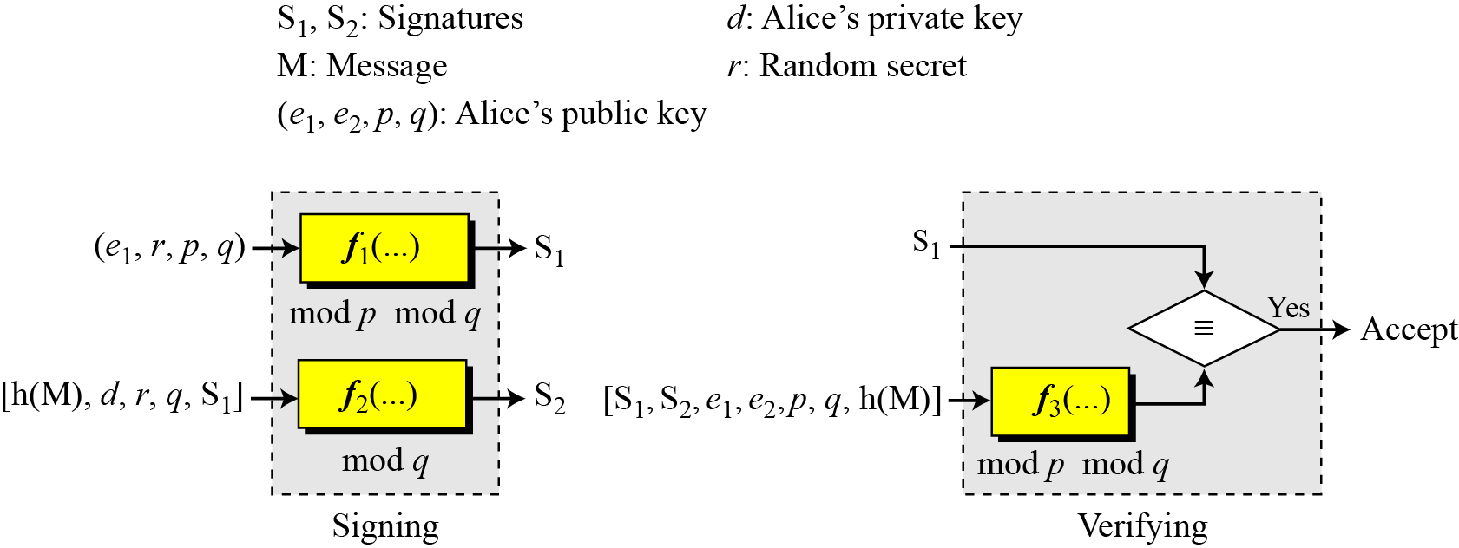
Diagrams
General DSS scheme

Slide 52
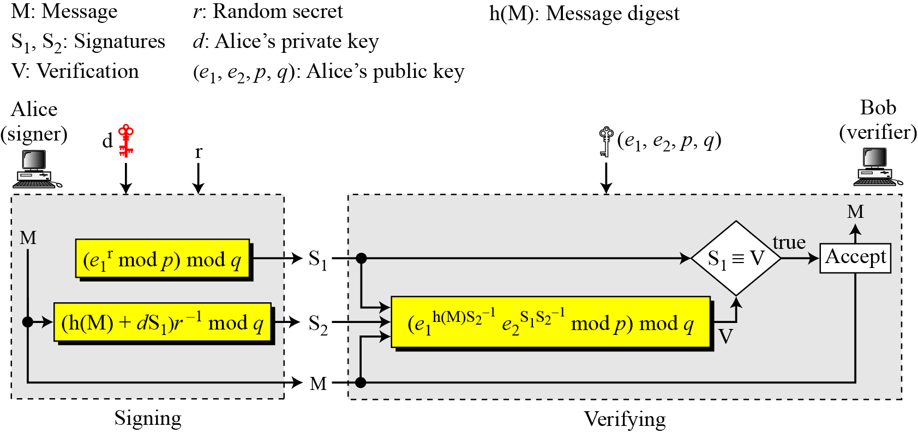
Diagrams
Verifying and Signing

Slide 53
Time Stamped Digital Signatures
Sometimes a signed document needs to be time stamped to prevent it from being replayed by an adversary. This is called time-stamped digital signature scheme.
Clock Synchronization problem??? Use Nonce
Nonce is an arbitrary number used only once to sign a cryptographic communication.
Repeated numbers can be discarded
Blind Signatures
Sometimes we have a document that we want to get signed without revealing the contents of the document to the signer.

Slide 54
Blind Digital Signatures
Need for cryptographic schemes which are similar to digital signatures but not quite the same.
A may require blindness
May want to obtain a signature from B on a secret message that he does not want to reveal to B.
Requirement of anonymity/unlinkability i.e. B should not be able to trace the signature back to A.
Electronic Voting
One Person One Vote and vote is valid
Do not want to reveal the message that who has voted whom
Suppose 3 Parties, U, Nadra, Election Commission
NADRA should verify U, only one vote, valid vote but should not know whom U have voted
Election commission should know whom you have voted but not your identity.

Slide 55
Blind Digital Signatures
Electronic Cash
In normal cash the bank knows they are giving cash to U but do not know where are you going to spend it
The salesman at the store knows where you are spending money but do not know your identity.
Is it Possible with Electronic cash? Bank would know about both.
In Electronic Cash we would like a similar scheme where bank knows U but not where you are spending and salesman knows where you are spending but not U.

Slide 56
Blind Digital Signatures to the Rescue
Blind Signatures based on RSA
Just like ordinary RSA, NADRA’s private key is d and public key is e. Calculated in the same manner as RSA.
Suppose NADRA selects p = 5 and q= 11 then n = 55, Φ(n) = 40
Suppose e is 7 (co-prime with 40) then d is 23
Suppose the message is ‘3’ and U don’t want to reveal this message to NADRA.
Introduce ‘r’ where r is a random number say 4
U calculates (3 * 4⁷ ) mod 55 = 37 i.e. (message * r^{e}) mod n = m’
NADRA calculates (37)²³ mod 55 = 53 i.e. (m’)^{d} mod n = S’ and sends it back to U
Remember that NADRA knows that whom it is communicating using some authentication scheme.
U calculates r⁻¹ mod n i.e. 4⁻¹ mod 55 = 14 (Could have calculated earlier too)
Multiplies r⁻¹ with S’ and gets S for m i.e. (14 * 53) mod 55 = 27

Slide 57
Blind Digital Signatures to the Rescue
Blind Signatures based on RSA
What would have been the original signature of NADRA for message m i.e. 3?
3²³ mod 55 = 27
Now U sends the message ‘3’ along with digital signature of NADRA 27 to Election Commission.
Election Commission verifies that the digital signature of NADRA is valid by passing to NADRA. (NADRA doesn’t know about the origin of the message, it can only verify that it is valid).
If NADRA verifies its signature, it is accepted by election commission.
Note:- NADRA needs the identity to communicate with U and can update the database as soon as he receives the request for vote from U
Note:- Election Commission receives the vote anonymously and only concerned that it has valid signatures from NADRA.

Slide 58
Blind Digital Signatures to the Rescue
For the Digital Cash
Similarly lets say you have received digital cash in the form of some 100 Rs Notes
The salesman (online) would demand that the digital cash should be signed by the Bank.
You generate a Message about the bank note.
You get the message m’ signed by the bank who returns S’ on m’
You extract the signature S of message m from S’ and now provide the message(bank note) along with the signature
The salesman sends your bank note to the bank (Note is coming from salesman now)
Bank now debits your account and salesman completes the transaction if bank verifies that the note is unspent. (Now bank knows who you are?)
Solution:- Oblivously pick the notes at the start. The second example will clarify.
Note: Just like regular Digital Signatures, normally the hashes are used instead of actual messages in Blind Digital Signatures.

Slide 59
A Problem with Blind Signing
The blinding attack
EVE has a message that is dangerous for NADRA to sign
EVE does not send the original message but the blinded one
NADRA signs the seemingly innocent document
EVE extracts the signature for the message it needed?
What attack is it?
Chosen Message
So Better to do with hashes
Do not use the same key for signing Blind Signatures and Normal Digital Signatures
There are DSS based scheme for Blind Signatures that are more secure

Slide 60
Problem with Blind Digital Signatures
Hundreds of thousands of voters trying to obtain blind signatures from the election authority??
The system would become overloaded.
Should a single person/entity deal with all the signatures’ processing
Group Digital Signatures to the rescue
We would like to have a number of Sub-Entities/Groups who may issue the blind signatures in NADRA and yet the election commission should be able to verify the signature using a single public key.
We Require Group Signatures

Slide 61
Problem with Blind Digital Signatures
Key Concept of Group Digital Signatures
Any members of a given group are allowed to sign on behalf of the entire group.
The signatures can be verified using a single group public key.
Once a document is signed, no one except a designated group manager should be able to determine which particular group member actually signed it.
No group member can forge another member's signature on a given document not even the group manager.
No Member can have/or generate a signature that is untraceable

Slide 62
References
https://www.venafi.com/blog/how-diffie-hellman-key-exchange-different-rsa
https://securityboulevard.com/2020/05/types-of-encryption-5-encryption-algorithms-how-to-choose-the-right-one/

